Slide 1
Dijkstra's Algorithm
Presented by
Antaine O’Conghaile & Brendan Toolan

Slide 2
Introduction

Slide 3
Brief Explanation of Algorithm
Computing Algorithm for finding shortest path between two vertexs of a graph
Each vertex/node assigned a distance value, starting node being zero
Preceeds to calculate the shortest distance between two nodes then take the simplest route

Slide 4
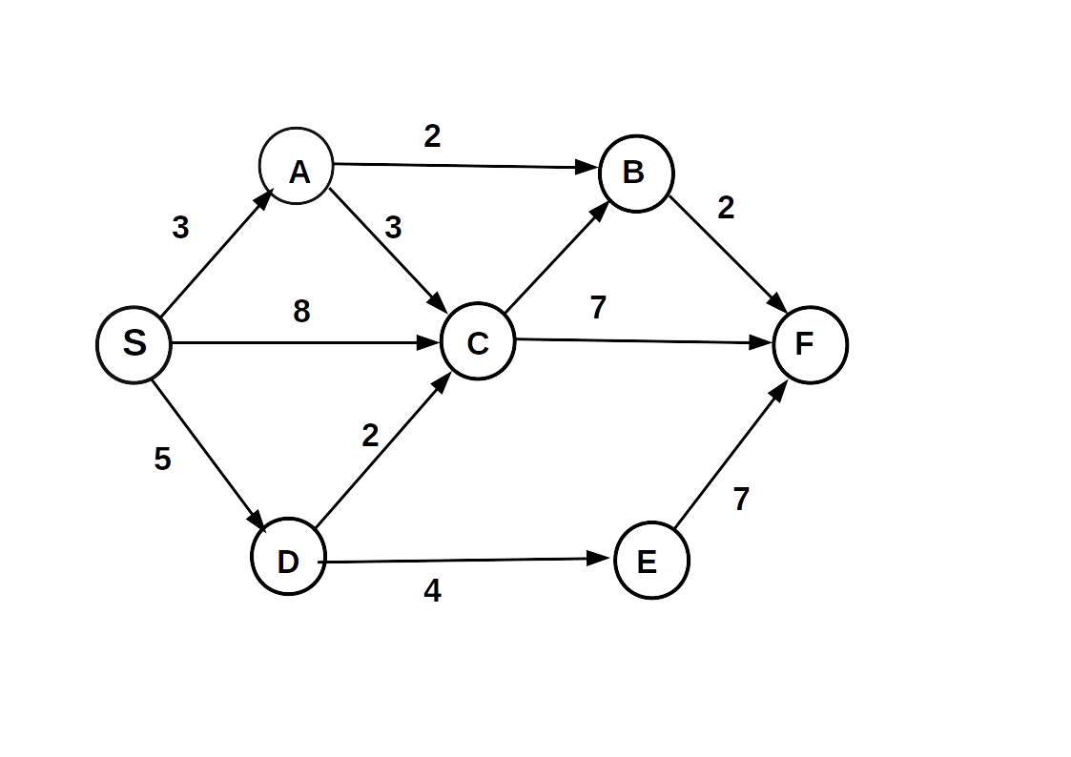
Example of Dijkstra Algorithm Graph

Slide 5
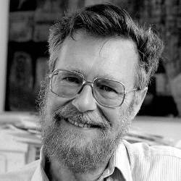
Dijkstra History
Founded by Edsger Dijkstra (1930-2002)
University Professor most of his life
Invented his algorithm of finding the shortest path between two points in 1959

Slide 6
Real Life Application

Slide 7
Pros and Cons
Pros

Slide 8
Conclusion

